Slide 1
Titanium Automation Architecture
Intel Tasks Platform - ITP
21^{sh} August 2014

Slide 2
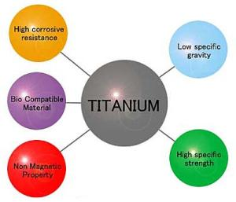
What we present
Tasks Platform - Objectives
Understanding Common Automation Pitfalls
PSE / ABT / ITP comparison
Tasks Platform - Overview
Examples – BMA / Titanium
Titanium Automation Architecture
TestCase in Code Appraoch
Automated TestCase Generation
ITP Stakeholders
Data-Driven Testing
Cross Module Reusability
Jira / Zephyr Integration
Benefits

Slide 3
Tasks Platform - Objectives
Effectively achieve test needs while satisfying overlapping needs in business and technical aspects
Yet another test framework ?? (Your thoughts are important to not to happen this)
Technical Needs
Test Needs
Business Needs
e.g
e.g.
Database design
Programming language
e.g.
Accurate settlement report
Identify bugs
Automate tests
Design tests

Slide 4
Understanding the reality
Why people get embarrassed when we ask to use our PSE automation framework?
Technical barriers
Service , Impl, test supporters and tests – multiple layers to expertise
Spring - dependency injection
Usability barriers
Complexity in test layer – first impression matters
No data-driven capability
Experts needed to achieve cross module reusability
Less involvement of manual testers
Who knows how to program-to-an-interface
I know java a little, am I expected to know Spring too to use this framework.
I want to send an auth call, are you saying I need to understand all 18 parameters in the first place?
I want to fill an excel sheet and feed to your test suit
I don’t know java a bit, can I contribute to your automation code?
We don’t have java experts.
Can we execute your tests in our module?

Slide 5
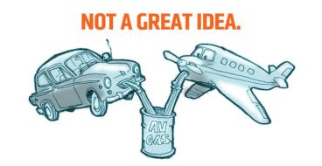
The reality in technical terms
Flexibility - QA APIs are inherently bound to DEV APIs with service / impl strategy and this limits flexibility during automation.
Although the ‘program to an interface’ is a fundamental OOP aspect in development, up to some extent, common test layers are not mandatory to adhere to that by sacrificing flexibility, because QA code is not going to integrate with production systems in general.
Usability / Reusability - Test scripts are difficult and little complex to understand for ordinary users, hence, they do not embrace this approach.
Maintainability – When tests are being failed in CI environments and it takes immense effort to fix those in QA releases. It is mandatory to have a way of fixing test issues quickly.
Since the test layer itself is little complex time-to-find-a-defect in automation code needs technical testers.

Slide 6
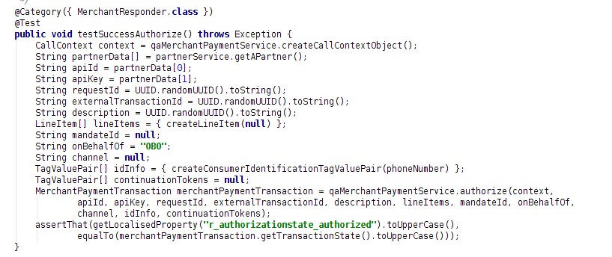
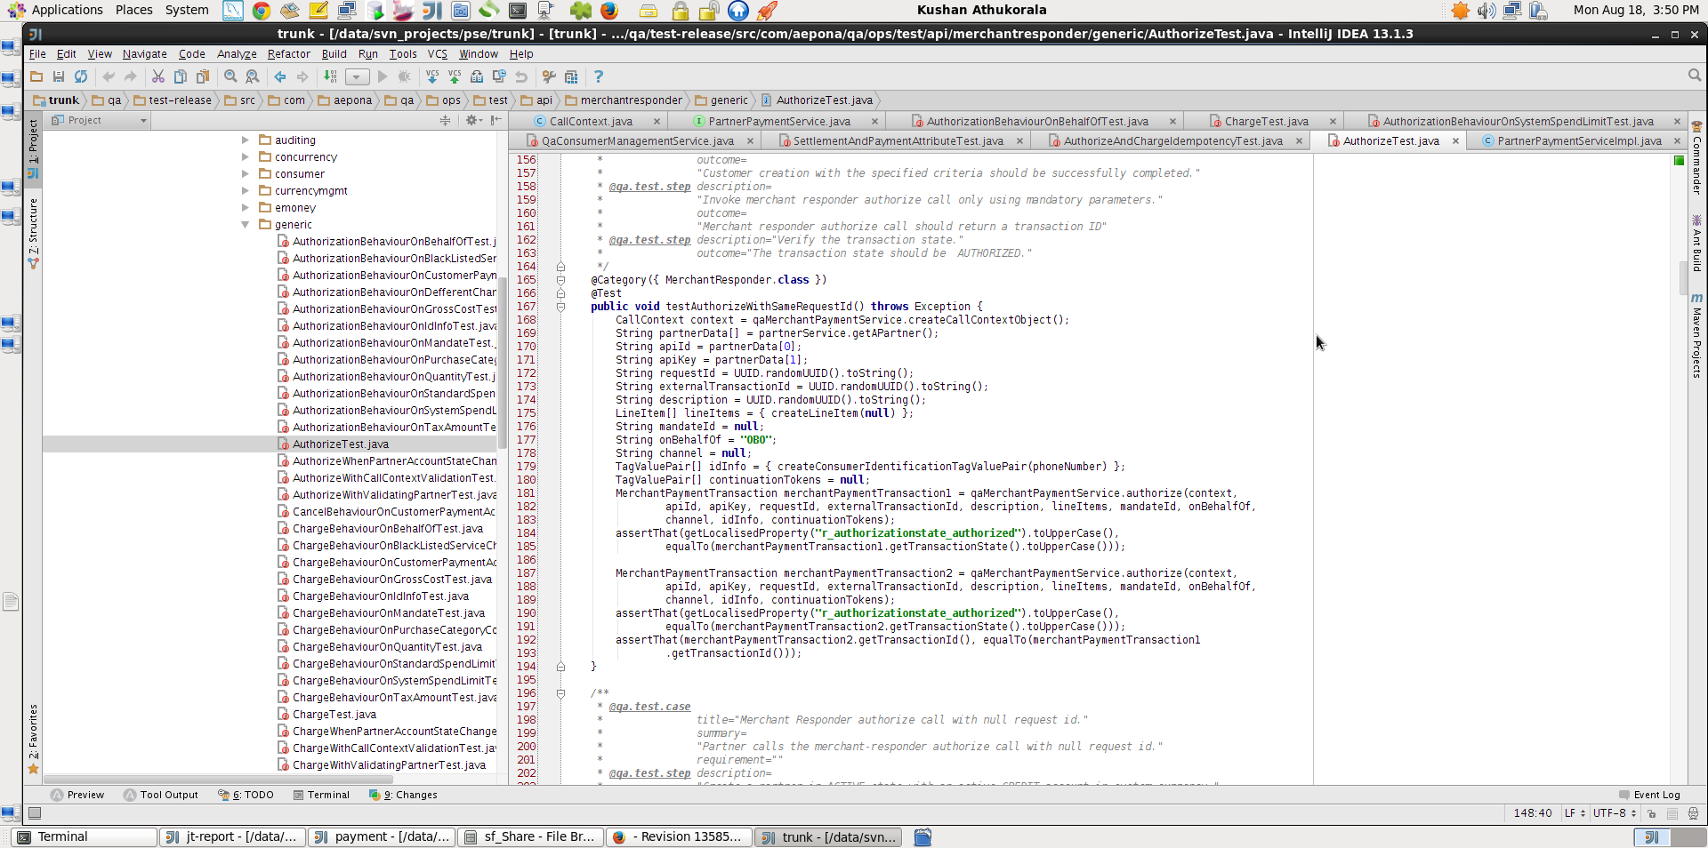
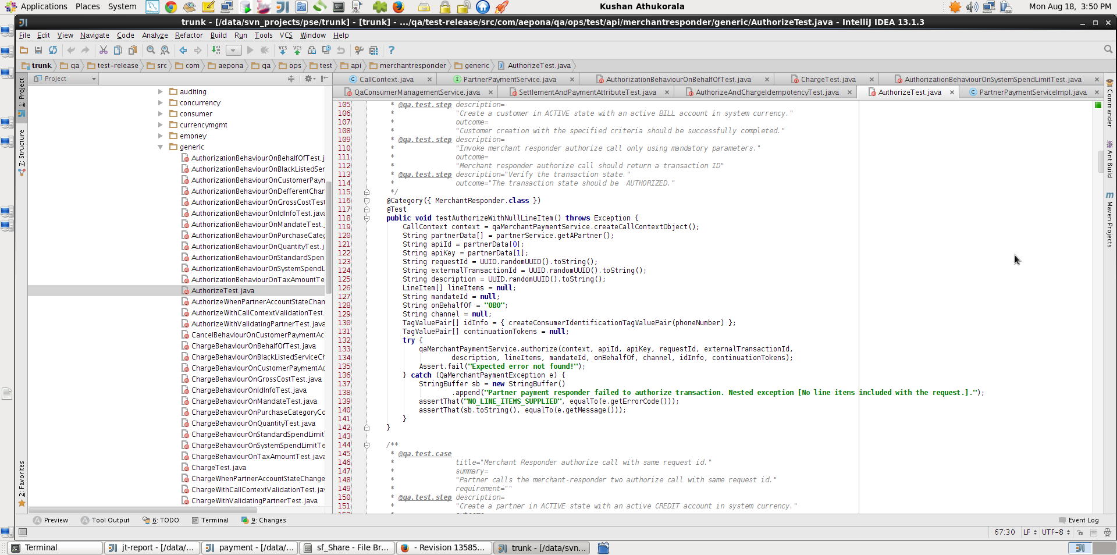
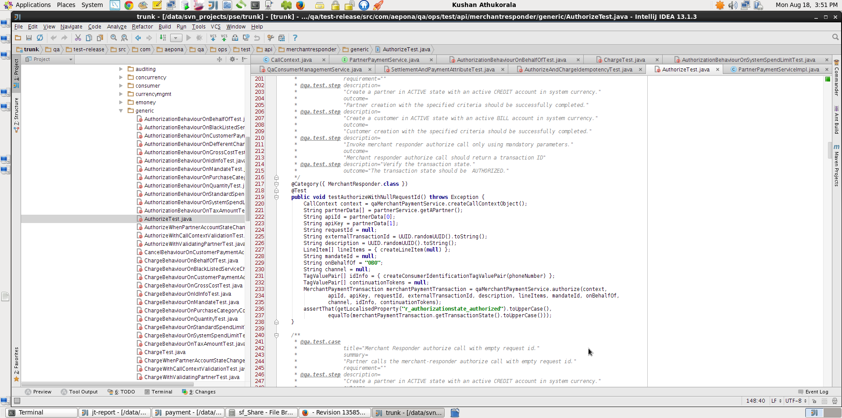
Authorize Test - PSE

Slide 7
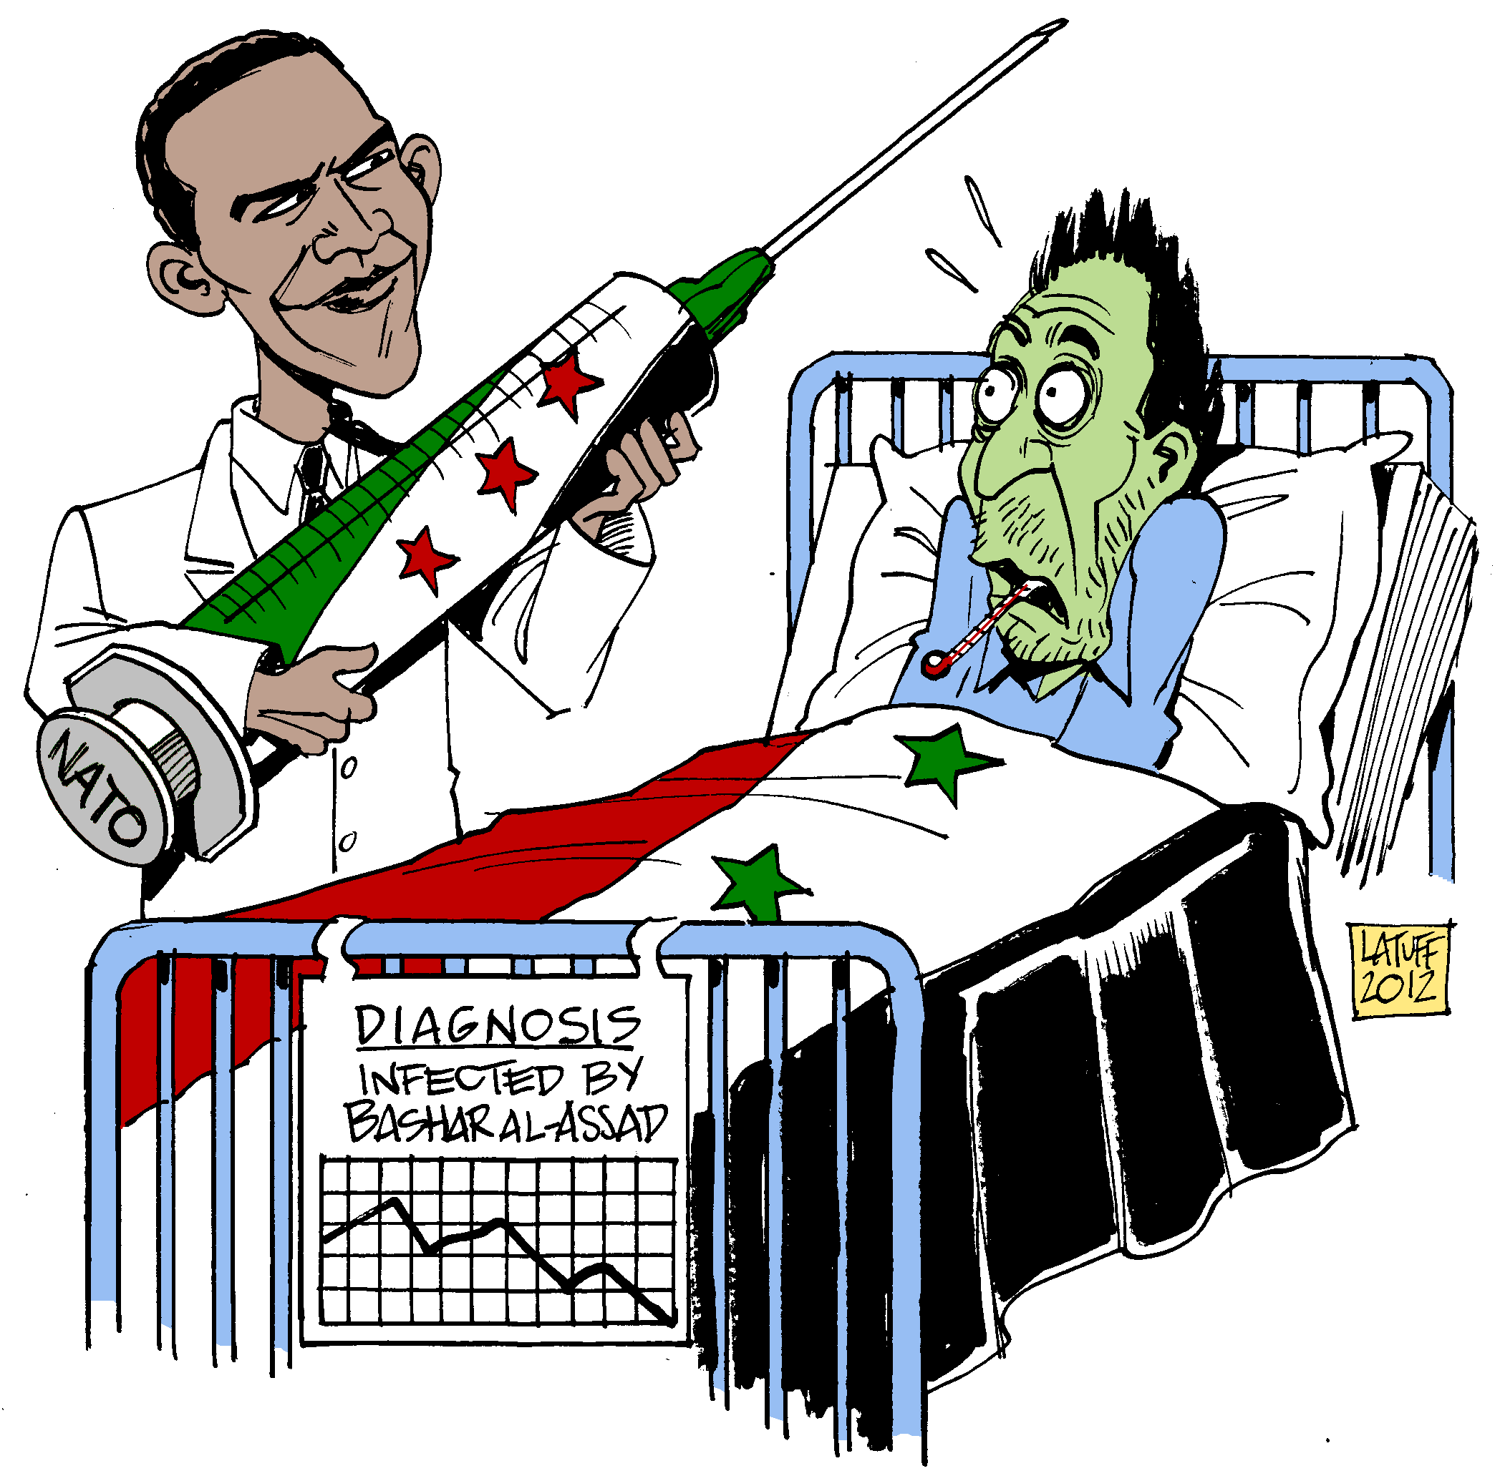
Drawbacks in ABT Automation Strategy
Targets only non-technical users, which, in turn, they do not test the system, but test the framework.
System goes live with defects
Story files are highly integrated to the automation code and other tracking systems. Therefore, change management is difficult.
Simple change to test flow would have a cascading impact to all integrated systems. This approach would be unstable in long-run with Agile testing approach.
Significant developer effort is needed

Slide 8
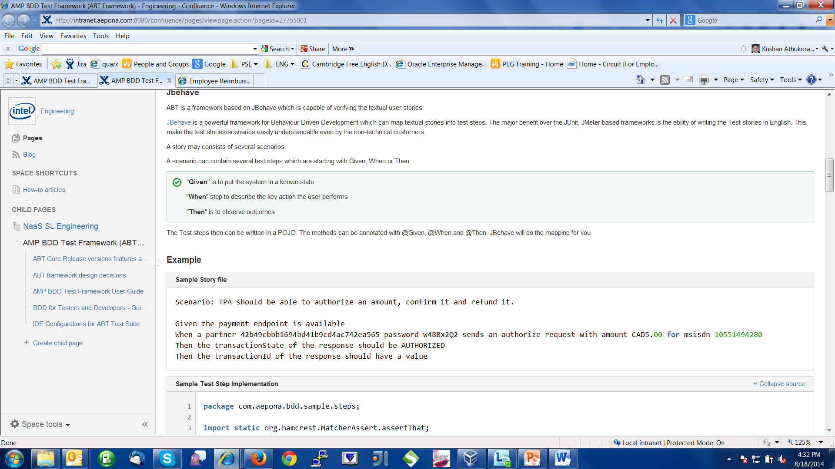
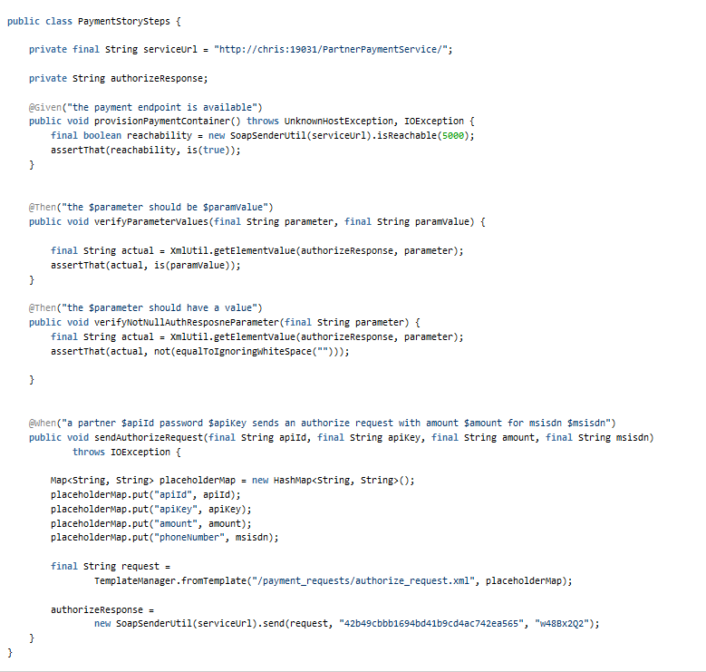
Authorize Test - ABT

Slide 9
Tasks Platform
Based on two basic principles,
Selecting composition over inheritance (Mandatory)
Method overloading (Mandatory)
Constructor overloading (Optional)
Constructor chaining (Optional)
Only two layers
Tasks Layer
Tests Layer
Service contracts have no direct exposer to Tests Layer

Slide 10
Tasks
A collection of reusable test pieces that relates to a common set of business logics, or coarse grained test logics, that can be repeatedly used in tests layer without strict adherence to an interface.
However, when the tasks are getting matured, it is better to have an interface defined.

Slide 11
Tasks Layer
Collections of tasks implementing abstract test logics and business abstractions that satisfy the test layer needs.

Slide 12
Example – Highly abstract modeling of Task Layer for BMA app
1. Tasks Aggregation – This shows how aggregated tasks can exist across multiple services
ConsumerManagementService
PartnerManagementService
ServiceProviderManagementService
1. UserTasks
CustomerTasks
PartnerTasks
ServiceProviderTasks
2. PaymentTasks
RefundTasks
SubscriptionTasks
MandateTasks
SpendlimitTasks
EventSummarizationTasks
3. SettlementTasks
ReprocessingTasks
4. ReportTasks
5. ManagementConsoleTasks
AgentTasks
2. Tasks Separation – This shows how separated tasks can exist for a single service
MerchantPaymentService

Slide 13
Titanium Automation Architecture
A
Simulators
Instance Tasks
Tests
Apps
Apps
Apps
Apps
Domain 1
Domain 2
Domain n
Utilities
Tests
Tests
Tests
Domain1 Tasks
Domain2 Tasks
Domain n Tasks
Common Tasks
Tests
Common
Platform Tasks
Tests
Platform
Automation Platform
System Under Test (SUT)

Slide 14
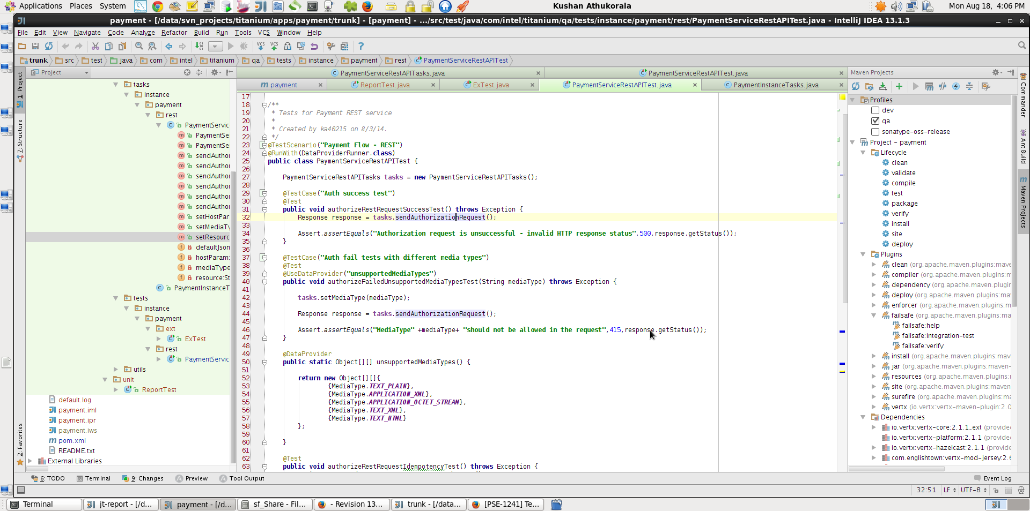
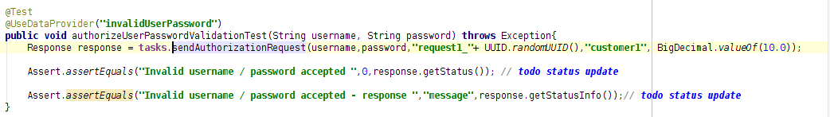
Authorize Test – Tasks Platform

Slide 15
Cloud Testing
Cloud testing is often seen as only performance or load tests though it covers many other types of testing
The initial setup cost for migrating testing to cloud is very high as it involves modifying some of the test cases to suit cloud environment. This makes the decision of migration crucial.^{[12]} Therefore, cloud testing is not necessarily the best solution to all testing problems.
Test scope need to be adjusted
Security and privacy

Slide 16
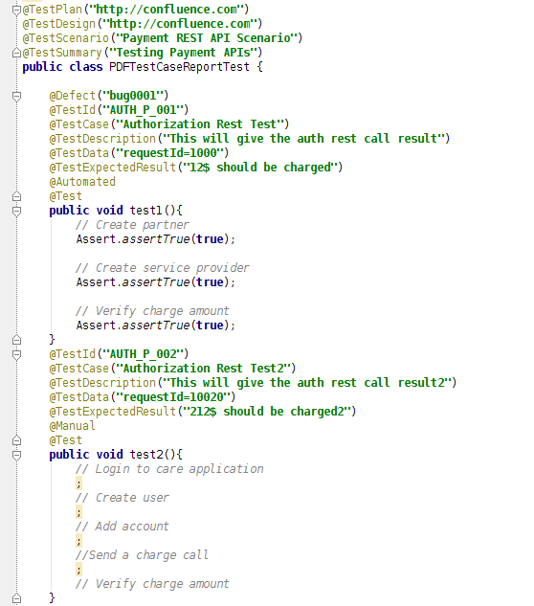
TestCase in Code Approach
Test Scenario
Automated TestCase
Automated Test Steps
Manual TestCase
Manual Test Steps

Slide 17
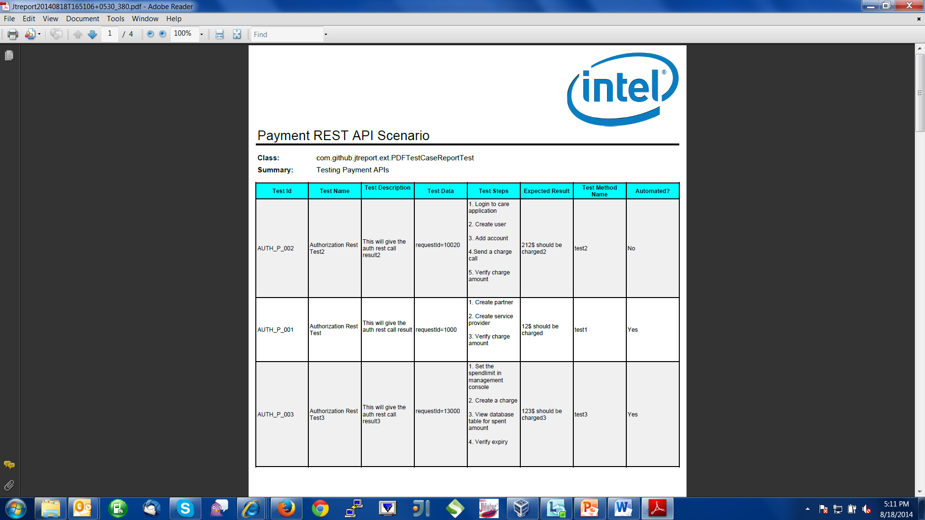
Automated TestCase Generation / Reporting

Slide 18
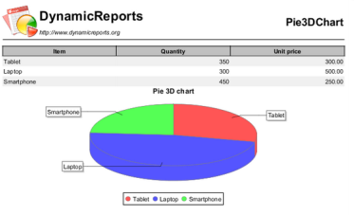
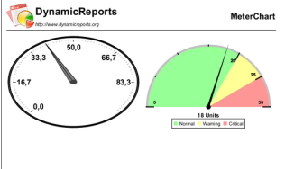
ITP Stakeholders
Technical Testers (Tasks Designers)
Manual Testers (Steps Writers)
Specialty here is that both Tasks designers and Step writers work on the same java code.
Product Owners / Managers – These people can see the test report in pdf format and give the feedback.
Customers
Since Jasper Dynamic Reports are being used for test reporting , it is possible to generate whatever type of graphical report.

Slide 19
Data-Driven Testing
TestNG like data provider support - Junit-dataprovider - Done
Fully externalizing data – TBD

Slide 20
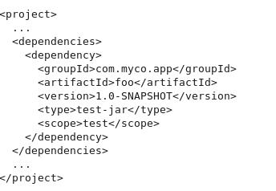
Cross Module Reusability - Tests / Tasks
Tasks and Tests can be kept as test dependencies in any module
Depending module users can
Execute dependent tests as is
Reuse tasks layer for their own test flows

Slide 21
Jira / Zephyr Integration
Use the Zephyr REST API
http://docs.getzephyr.apiary.io/

Slide 22
Benefits
Approach is technology / domain / architecture agnostic
Concise Test Layer
No service contracts exposed to test layer
No multiple layers to program
Data-driven capability
Cross module reusability
Support both manual and automated tests
Automated testcase generation
Customizable test reporting capability

Slide 23
Future Goals
Asynchronous / Parallel Testing
Fully data-driven testing

